Slide 1

Making IT accessible for all!
Matthew Deeprose
Tamsyn Smith
Dr Fiona Strawbridge
Notes:
Good morning. Welcome to ‘Making IT accessible for all!’

Slide 2
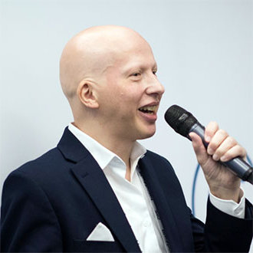
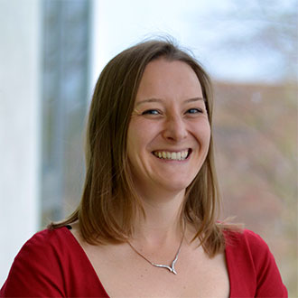
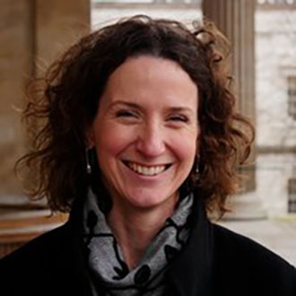
Who we are
Matthew Deeprose
Senior Learning Designer
University of Southampton
Tamsyn Smith
Senior Learning Designer Team Lead
University of Southampton
Dr Fiona Strawbridge
Director of Digital Education
University College London
Notes:
My name’s Tamsyn Smith and I’m Senior Learning Designer Team Lead at University of Southampton. I’m a white woman in my early 40s with shoulder-length brown hair. I’m joined by Dr Fiona Strawbridge, Director of Digital Education at UCL and Matthew Deeprose, Senior Learning Designer at Uni of Southampton.

Slide 3
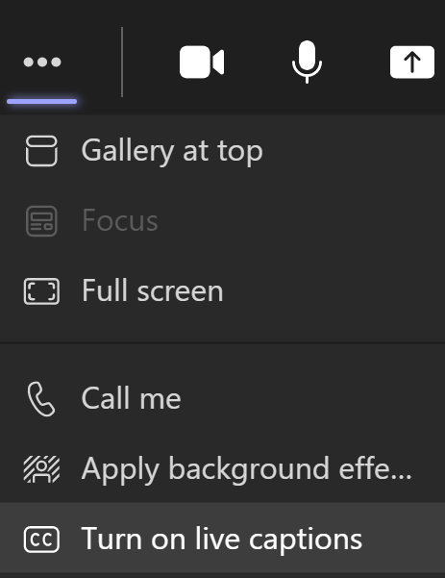

Housekeeping
The session will be recorded.
Turn microphones and cameras off.
Automated captions available.
Notes:
Today’s session will be recorded so please keep your cameras and microphones off unless we’ve come to you for a question.
We’d like to encourage you to post any questions and comments that you might have in the chat box.
It is possible to turn on automated captions in Teams by selecting the ellipsis (three dots) and choosing turn on live captions.
A recording with corrected captions will be made available via the presentation website. Likewise, the PowerPoint, relevant links and more will be available online afterwards. There are two PowerPoint slide decks, the one we use in this session, and a fuller version with more details.

Slide 4
Housekeeping 2
Question breaks
Acronyms
Polls
Continuing the discussion
Notes:
We’ve got various points where we’ll pause for questions as well as having a few minutes at the end of the presentation.
As we’ve only got an hour to cover a huge topic, we have assumed that everyone has some knowledge of accessibility. We’ll share acronyms in the chat, but please post a comment if anything requires clarification.
During the session, there will also be some polls using MS Forms.
We’re also hoping that discussions will continue in the Jisc Accessibility Community in Teams.

Slide 5
Two polls ready to answer
Does your IT department have an IT accessibility policy?
Don’t know.
No, and no plans to create one.
No, but we are starting to consider it.
Yes, but it has not been approved.
Yes, and it has been approved.
Does your IT department have an accessibility testing process?
Don’t know.
No.
Some accessibility testing is done informally.
Yes, we have a formal accessibility testing process.
Notes:
In the chat you should find two polls to answer, “does your IT department have an IT accessibility policy?” and “Does your IT department have an accessibility testing process?”. You may need to scroll further up the chat to find them. Please complete the polls if you can, while we start our introduction

Slide 6
Challenges and opportunities
How to respond?
What policy?
What processes?
So many services!
What is achievable?
Empowering all users
Developing IT staff
New efficiencies
Better experience
Prioritisation
Accessible by design
Notes:
Experiences of the past 18 months, as well as legislation, have demonstrated the importance of accessibility.
[REVEAL]
For University IT departments this brings challenges:
How can we respond to these expectations?
What about our policies and processes?
University IT departments support a large number of services. What is achievable with limited resources?
BUT there are many opportunities. [Reveal next part]
An important part of accessibility is helping all users to understand and use accessibility features.
Accessibility skills are in-demand among employers, so developing such skills in our IT staff is a great opportunity.
Adjusting our processes and practices, for example by annotating wireframes for accessibility, or building an accessible component library can bring efficiencies, allowing us to create new services and sites that are accessible first, and delivering an improved user experience.
We do need to be realistic - when procuring or developing new services there may be obstacles to providing a fully accessible experience. We will show you methods for prioritising accessibility defects and taking ownership of accessibility.
We have the opportunity to develop IT services that are “Accessible by design”.

Slide 7
Why concentrate on IT departments?
Institutional approach: most effective.
IT departments have specific attributes.
Lots of services
Leaders
Technical details
Potential impact
Embedded in institution
Can act now
Notes:
We can’t deny that an institution-wide approach is ideal.
It helps us to secure a mandate, budget, and buy-in from the University executive.
But IT departments have particular attributes,
[NEXT]
…they are responsible for most, if not all, of the University’s digital estate, so implementing technical solutions that meet accessibility guidelines can only really be done by the IT department. They tend to be embedded within their institution, touching almost all aspects, and are often looked to for leadership.
IT departments can have a significant impact, and they have the chance to act now.

Slide 8
In this presentation we aim to
… but we won’t have all the answers
Place digital accessibility within a wider-context.
Introduce a pathway for implementing digital accessibility within your IT department.
Share practical examples of how accessibility can be embedded within the policies and processes of an HE IT department.
We’re all at different stages in this journey.
As a community we can share practices and progress.
We’ll follow up unanswered questions after this event.
Notes:
In this presentation we will share some background to put accessibility trends in context, and introduce you to a pathway for implementing digital accessibility within your IT department.
We’ll share practical examples of how accessibility can be embedded within the policies and processes of an HE IT department.
[Next]
But we won’t have all the answers – we’re all at different stages of this journey but as a community we can share practices and progress.

Slide 9


Where are you on the maturity model?
1 2 3 4 5
Stage | Luck | Tokenism | Standards | Ownership | Partnership
Typical quote | With luck no one will ask us about accessibility. | We have one accessibility statement. It's on our corporate site. | All our systems meet WCAG 2.1 AA. | We’ve adapted our policies and processes to ensure the accessibility of our services. | We co-design and test services with users, including those with disabilities or impairments.
Notes:
We’ll start with a poll to find out where everyone thinks they are. We’ve adapted, with permission, this opening table from the McNaught / AbilityNet Accessibility Maturity model.
Consider the mindset and actions of your IT department regarding digital accessibility, where do you see yourselves on this maturity model?
Are you hoping that no one will ask about accessibility?
Or perhaps you have added an accessibility statement on the corporate site, but not taken much other action?
Compliance with standards is vital, but fixating on standards will not realise the maximum potential.
Taking ownership and adapting policies and processes for accessibility should lead to sustained delivery of services that meet accessibility guidelines and will help to ensure that IT staff know and understand the benefits of accessibility.
The highest level of maturity is working in partnership with users (including those with disabilities and impairments) to co-design and test services.
In our presentation today we will be focussing on standards, ownership, and partnership levels of maturity.

Slide 10

Background and context
Notes:
Before we get into the main part of our presentation, let’s consider some of the context of Digital Accessibility.

Slide 11

Disclosure
Notes:
Disabled students now make up a sizeable minority of the student population. The number is under-reported because many students will not show in the official data.
Research from Advance HE found the proportion of University staff disclosing as disabled has almost doubled within the last decade.
Accessibility affects all of us, everyone will experience some kind of disability or impairment at some point in their lives.
But accessibility isn’t only about supporting those with a disability or impairment. Accessible practices benefit everyone.

Slide 12

Changing perspectives
Notes:
Increasingly, we have opportunities to normalise and expand the benefits of accessible practices to all and explain the wider benefits.

Slide 13

Nicola Yap, Google
I challenge you to reframe accessibility as customisation.
…features like dark mode or captions are really a way to customise your user experience, and these customisations are beneficial to everyone.
We all find ourselves in different contexts where we need to adjust how we interact with our devices and the people around us.
Notes:
Nicola Yap, a Technical Writer for Google Cloud, has written that we should reframe accessibility as customisation.
Accessibility features can benefit everyone. It’s important to explain these benefits to our user-population so that they can make more effective use of our services.
https://blog.google/outreach-initiatives/accessibility/world-sight-day-accessibility-customization/

Slide 14
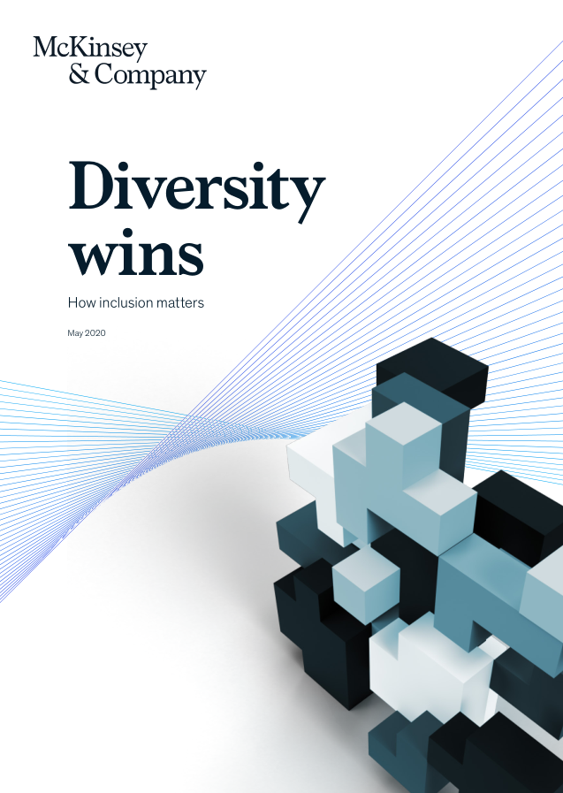
“Diversity wins”
“Greater diversity… is correlated with significantly greater likelihood of outperformance. More than that, fostering a diverse and inclusive culture is a critical success factor: it enables individuals both to shine in their own right and to pull together as a team.”
Notes:
Research shows that the more diverse an organisation the more likely it will out-perform, but how can we foster that diversity unless our services are accessible?
https://www.mckinsey.com/featured-insights/diversity-and-inclusion/diversity-wins-how-inclusion-matters#

Slide 15

Choosing a path
Notes:
We mentioned earlier that we presenters are all at different stages on this journey, and it’s fair to say that we are all very far from meeting our goals and objectives within digital accessibility. We identified several possible pathways to follow for embedding digital accessibility within our policies and processes.

Slide 16
Planning and Managing Web Accessibility 0
Initiate
Implement
Sustain
Plan
Notes:
The World-wide web consortium’s Planning and Managing Web Accessibility guide is a straightforward and digestible approach to implementing digital accessibility within an organisation.
It breaks down the path through four steps.

Slide 17
Planning and Managing Web Accessibility a1
Initiate
Plan
Implement
Sustain
Learn the basics
Explore current environment
Set objectives
Develop business case
Raise awareness
Gather support
Create policy
Assign responsibilities
Budget / resources
Review
environment
websites
Monitoring
Engage stake holders
Build skills and expertise
Integrate goals into policies
Assign tasks Evaluate
Prioritise issues
Track / communicate progress
Monitor services
Engage with stakeholders
Track standards and legislation
Adapt to new technologies
Incorporate user feedback
Notes:
Each of the steps has a discrete set of activities. In the full presentation (which you can access online) we explain all of these and relate to them to the context of a University IT Department.

Slide 18
Planning and Managing Web Accessibility a2
Initiate
Plan
Implement
Sustain
Learn the basics
Develop business case
Create policy
Assign responsibilities
Budget / resources
Review
websites
Integrate goals into policies
Prioritise issues
Overview
Notes:
During the rest of this hour we’re going to concentrate on what we believe will be most important and valuable for you. We will discuss learning the basics, developing the business case, creating a policy and determining budget and responsibilities, reviewing our websites, integrating goals into polices, and prioritising issues. We will give an overview of the recommendations for sustaining these activities.

Slide 19
Planning and Managing Web Accessibility 00
Sections of this presentation are based on “Planning and Managing Web Accessibility” from the Web Accessibility Initiative (WAI). Copyright © 2021 W3C® (MIT, ERCIM, Keio). Status: Updated 31 March 2016.
https://www.w3.org/WAI/planning-and-managing/
Notes:
The whole W3C guide is available online and the link is available on our presentation support website.
Now I’m handing over to Matt to start reviewing this pathway and its context for University IT departments.

Slide 20
Planning and Managing Web Accessibility 1
Initiate
Implement
Sustain
Plan
Notes:
Thanks Tamsyn. Hello everyone, I’m Matthew Deeprose. For those who cannot see me I’m a bald white male, in my forties, wearing a black jacket and a green shirt.
In this first stage, initiate, we’re concerned with developing an understanding of accessibility and building departmental enthusiasm.

Slide 21
Learn the basics
Learn the basics
Set objectives
Develop business case
Raise awareness
Gather support
Explore current environment
Notes:
By learning the basics, we mean finding out what accessibility is and why it’s important.
The better you and your colleagues understand accessibility, the more effectively it can be implemented and promoted within your department.

Slide 22

Resources for learning the basics
Talk with colleagues, friends, and family members with disabilities.
Notes:
Research by the charity Scope found that 40% of households include a member with a disability.
So talk with colleagues, friends, and family members with disabilities about their experiences.
On the support site, I’ve added some useful introductory resources. If you haven’t tried it yet, the Accessibility Maze is an online game that you and your colleagues can play to learn more about accessibility.

Slide 23
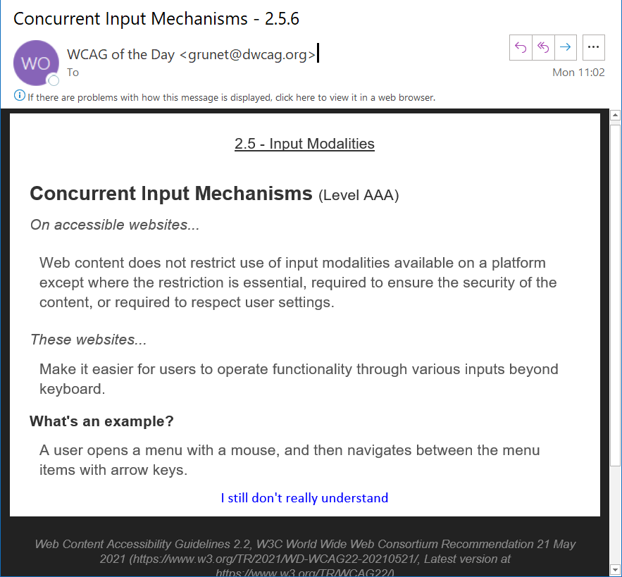
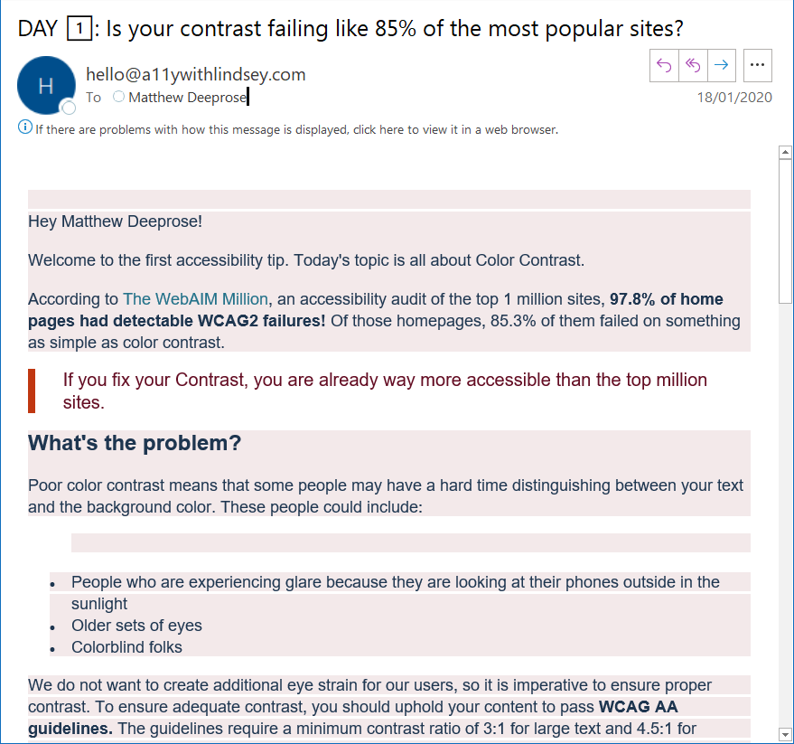
Automated emails for learning the basics.
WCAG of the Day
10 Days of A11y
Notes:
You could sign up for an automated email that teaches you a little about digital accessibility each day. For example “10 Days of accessibility” and Web Content Accessibility Guideline (WCAG) of the day”

Slide 24




Mailing lists / Communities
Mailing Lists:
ATHEN
WebAIM
JISCMail
Web A11y Slack
JISC Accessibility Community
Worldwide Accessibility Discord Server
Notes:
And there are numerous online communities and mailing lists. All these links are on the presentation support site.
Access Technology Higher Education Network Mailing List
https://mailman12.u.washington.edu/mailman/listinfo/athen-list
https://webaim.org/discussion/
https://www.jiscmail.ac.uk/cgi-bin/webadmin?A0=DIGITALACCESSIBILITYREGULATIONS

Slide 25
Test a few university sites
Keyboard navigation
Accessibility Insights
Navigate corporate site using a keyboard?
Automated accessibility defects found on high usage sites?
Notes:
As you learn about accessibility - try out a few of your own websites by using a keyboard, or using a browser based accessibility checker.
For example, load up your corporate site and go through the process of ordering a prospectus using your keyboard instead of a mouse or trackpad.
Or install the free accessibility insights browser plugin from Microsoft and try running a “fast pass” on a few of your sites and services.
How many issues can be identified automatically and what are they?

Slide 26
Develop business case
Learn the basics
Set objectives
Develop business case
Raise awareness
Gather support
Explore current environment
Notes:
A strong business case helps gain buy-in from stakeholders and can make accessibility a departmental priority.

Slide 27
What is a business case, and what does it do?
Elevator pitches
Project document
Report or position paper
Gain buy-in from stakeholders
Tailored to the department / institution
Set priorities
Aim to obtain financial support
Notes:
In this context, what do we mean by “business case”? It may be a “stockpile” of arguments or elevator pitches that you use, or it could be a project business case, or a report or position paper.
[Move forward]
Regardless, the aims are that through your arguments being tailored to your department, you can gain buy-in, set accessibility as a priority, and ideally obtain financial support.

Slide 28
The business case could explore 1
Context of staff and students with impairments
Benefits for all
Social responsibility / relation to existing strategies
The legal context
Financial and technical benefits
Staff development benefits
Notes:
What’s relevant to explore in the business case will vary between institutions. In the next slides I’m going to highlight a few different angles.

Slide 29
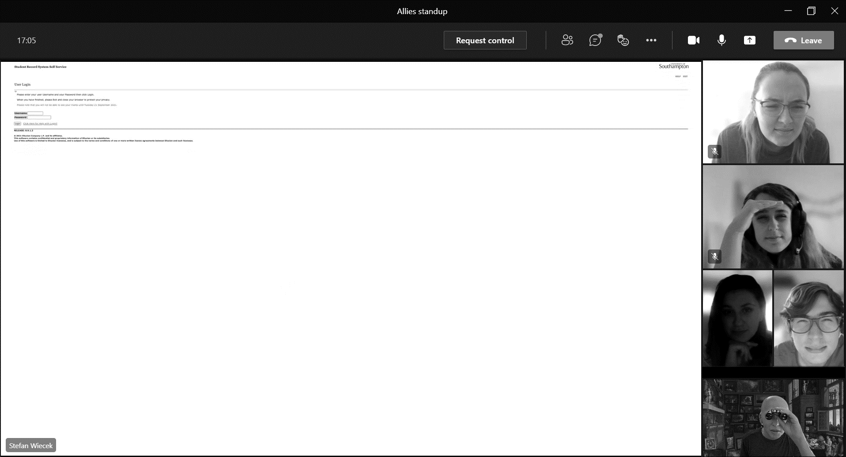
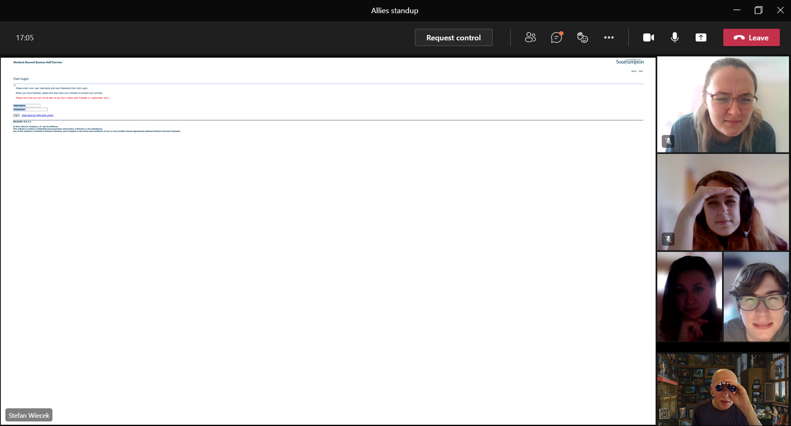
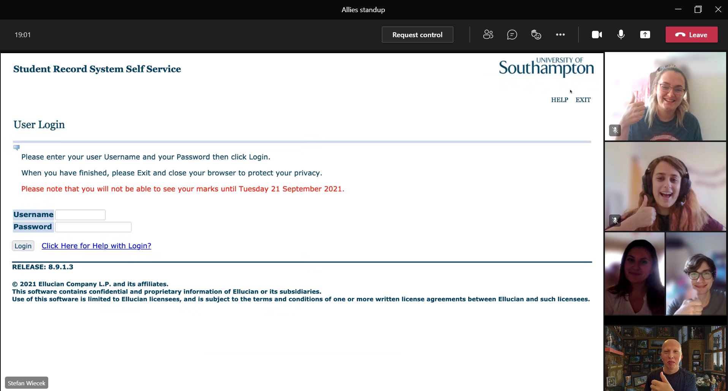
Examples of everyday accessibility: Browser zoom 1
Notes:
We’ve mentioned accessibility features can be considered customisation features.
In online meetings, it’s likely that someone has asked for a screen share to be made larger.
[Move forward]
This is dependent on the application reflowing, which is an accessibility Success Criterion.
Our business case can explain the benefits both of our services following accessibility guidelines, and how explaining these benefits to our users can help raise effectiveness and digital literacy.

Slide 30
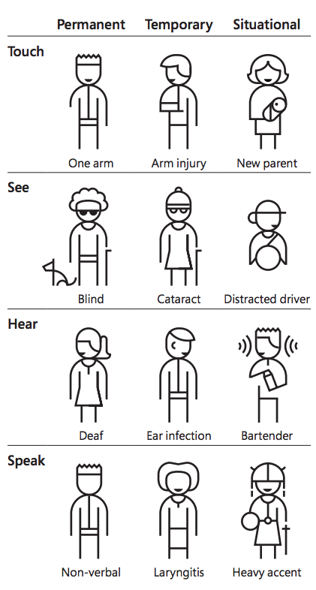
Maximise the potential of the University’s digital estate for all stakeholders.
Microsoft Design
Notes:
Not to diminish the experience of those with permanent disabilities or impairments, we may find ourselves dealing with a temporary impairment such as a broken arm, or a situational impairment such as using our device in a bright light.
As the W3C says, “accessibility is essential for some, but useful for all.”
Following accessibility best-practices will help to maximise the potential of our investment in online services for everyone.

Slide 31
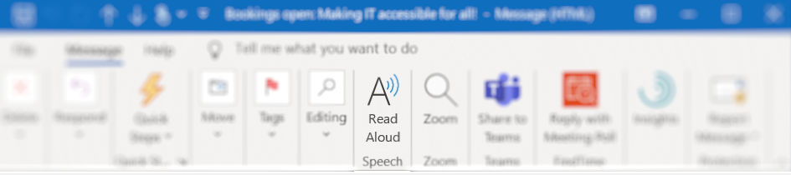
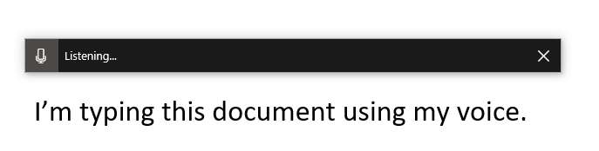
More examples of everyday accessibility
Notes:
Many accessibility features could be thought of as “dormant” within the computers of our colleagues.
Simple techniques such as having your email read aloud to you or knowing how to turn on dictation features can benefit many.
So a key part of our business case could be showing the benefits to all our users.

Slide 32
Access and Participation Plan
Disclosure trends
Goals
Notes:
Review your institution’s access and participation plan to identify disability disclosure trends. Understand your institution’s access and participation goals.
So much of the University experience is digital, so accessibility can play an important part.

Slide 33

It’s the right thing to do.
Notes:
Most would agree that ensuring our services are accessible is the “right thing to do”

Slide 34
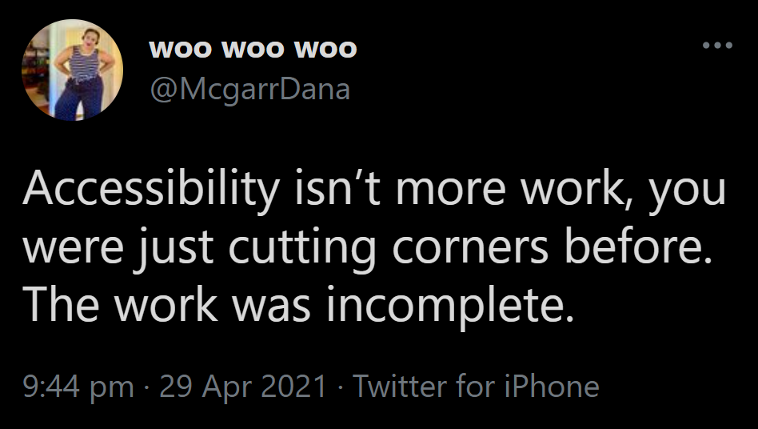
It’s the right thing to do 3
Notes:
Or even just “the thing to do” – if we weren’t testing the accessibility of our services before, our work was not complete.

Slide 35

The legal context
Public Sector Bodies (Websites and Mobile Applications) Accessibility Regulations (PSBAR).
Notes:
Many will have become aware of the requirement for accessible digital services through the Public Sector Bodies (Websites and Mobile Applications) Accessibility Regulations 2018 which I will now refer to as “PSBAR”.
The regulations set testable standards for web sites, documents, and mobile apps to meet in order to prove their accessibility, and a way for organisations to report on their compliance.

Slide 36
What’s the worst that can happen? 2
EHRC investigation following report and monitoring by CDDO
Discrimination claim by injured party
Reputational damage
Notes:
Failure to comply with the accessibility regulations, could result in:
An Equality and Human Rights Commission investigation.
A discrimination claim by injured party
Or reputational damage
…
A discrimination claim by injured party – the regulations assist someone who wants to establish causation in a discrimination claim. The risk for an education provider, for example, is that an individual student who has failed a course could more easily link inaccessible content and discrimination.
Thank to John Kelly as JISC for explaining these worst case scenarios.

Slide 37
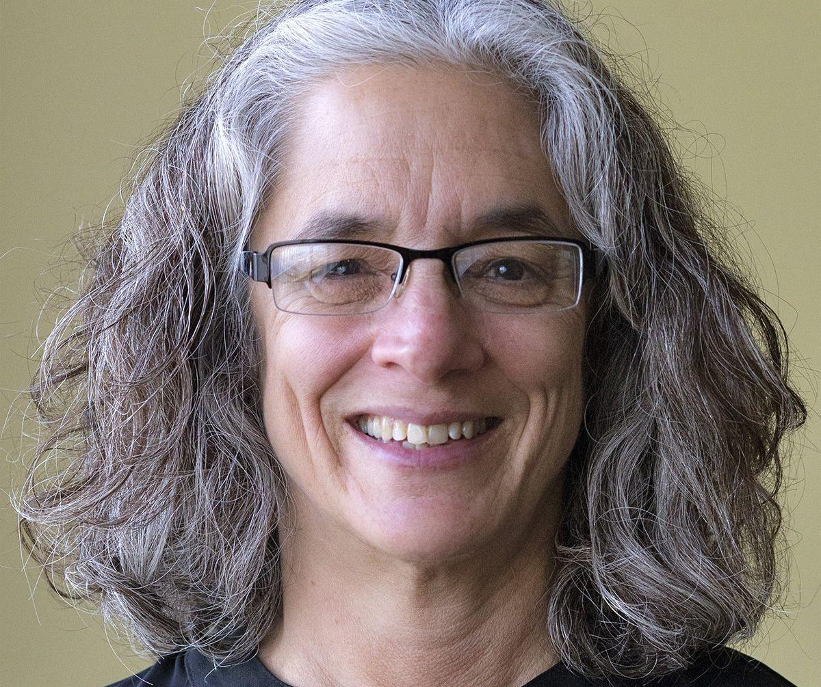
Disadvantage of legalistic approach
“When organisations work on accessibility only because they are afraid of being sued… they inevitably stop at compliance because that is the point where litigation risk ends.”
Lainey Feingold, LFLegal.com
Notes:
The legalistic approach should not be the only argument in your business case. As Lainey Feingold a disability rights lawyer in the US writes, it may mean organisations stop at the point of standards compliance.

Slide 38
WebAIM Hierarchy for motivating accessibility change
Inspire
Enlighten
Guilt
Reward
Require
Punish
Effectiveness
Notes:
The organisation Web Accessibility in Mind has published a hierarchy for what motivates accessibility change.
They believe the lower elements: guilt, punish, and require are not necessary for effective motivation, even though they are the most commonly used.
Rewarding, enlightening and inspiring are much more powerful, try to consider this in your business case.
https://webaim.org/blog/motivating-accessibility-change/

Slide 39
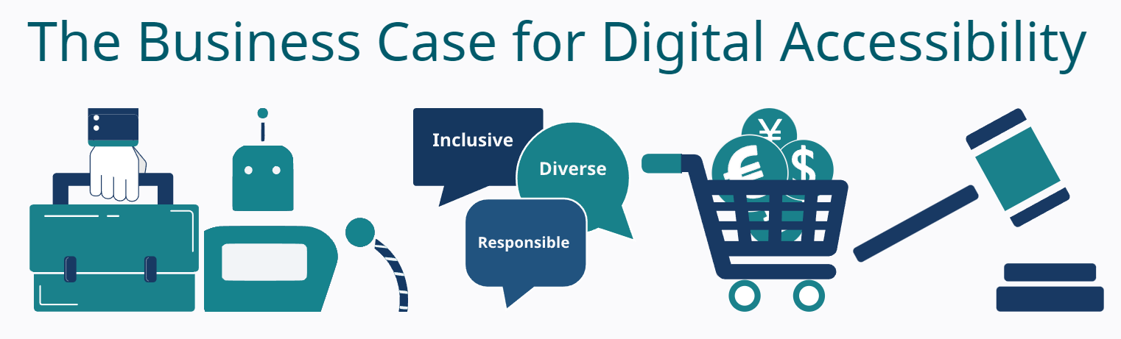
Further resources
https://www.w3.org/WAI/business-case/
Notes:
Implementing accessibility has development benefits for our IT staff through growing their marketable skills. Research by the Wall Street Journal found that the number of job listings with “accessibility” in the title increased by 78% in the past year.
There is a growing demand for IT staff who are competent in accessibility. And this will only increase.
You can find more ideas on the W3C’s website and in the full slide deck.
__
https://www.w3.org/WAI/business-case/

Slide 40

Question and answer break 1
Initiate
Implement
Sustain
Plan
We are here
Notes:
Before we look at the planning stage I’ll hand over to Tamsyn to see if there are any questions from the chat.

Slide 41
Planning and Managing Web Accessibility
Initiate
Implement
Sustain
Plan
Notes:
Careful planning is critical to effective implementation of any accessibility effort. It ensures a clear assessment of the required work, distribution of tasks, and continual follow-up on progress.

Slide 42
Plan 0
Create IT accessibility policy
Who is responsible?
Budget and resources
Review environment
Review websites
Establish monitoring
Engage stakeholders
Notes:
Fiona is going to share her experience of building an IT accessibility policy, establishing responsibilities and requesting budget and resources. Later I’ll share our approach to building accessibility testing capability. Over to you Fiona.

Slide 43
Create IT accessibility policy
Create IT accessibility policy
Who is responsible?
Budget and resources
Review environment
Review websites
Establish monitoring
Engage stakeholders

Slide 44

Evolution of a Digital Accessibility Policy at UCL
Notes:
Fiona to give description of herself

Slide 45
Scope
Digital products/services/platforms – whether developed in-house or bought in
Online content – on websites, intranets, wiki, blogs, social media
Digital documentation – that are shared with others
Multimedia – audio, video and images
Teaching and training content – resources, presentations and multimedia

Slide 46
Style
Simple language with links to more guidance
An example:
Documents which are prepared for institutional use such as meeting and committee papers, reports, guides, manuals etc. must be prepared using the guidance on structuring and formatting documents.
Creating Accessible Documents guidance.
Staff should use the Microsoft Office accessibility checker to check the accessibility of Word, Excel and PowerPoint files and take action to address any problems.

Slide 47

The policy requires
Compliance with WCAG 2.1AA
Evidence of product compliance from supplier
Evidence of supplier commitment – exception reports if this isn’t possible
Testing of products
Accessibility statements for products & services
This Photo by Unknown author is licensed under CC BY.

Slide 48

It's a balancing act...
This Photo by Unknown author is licensed under CC BY.

Slide 49
Roles and responsibilities
Type of digital asset | Responsible | Accountable
General content | Individual staff
Procured products, services, platforms | Project managers | Commercial Director
In-house products, services, platforms | Project managers | CIO

Slide 50
Budget and resources
Focused on teaching content
1 FTE to support specialist content (maths, specialist notation etc.)
1 FTE for more general support
3,000 hours of student time to tag images, correct transcripts, etc.

Slide 51

Getting sign-off
Shared drafts with key stakeholders
Equity, Diversity and Inclusion Committee
Education Committee
Academic Board
This Photo by Unknown author is licensed under CC BY-SA.

Slide 52
Review websites
Create IT accessibility policy
Who is responsible?
Budget and resources
Review environment
Review websites
Establish monitoring
Engage stakeholders
Notes:
Thanks Fiona! It’s Matt here again. Now that we have a policy, it’s time to review our existing websites within the scope of our objectives.

Slide 53
Review your web estate
Audit for accessibility
Create a baseline
Review results
Problems / ‘anti-patterns’ to be avoided.
Identify training / expertise gaps
Look for good practice.
Defects / prioritisation
Report to stakeholders
Notes:
This allows us to identify issues to be fixed in existing websites and avoided in future releases, creating a baseline for future work and identifying where training is needed.
Results are helpful in stakeholder reporting activities. We can highlight existing problems and their impact so that later on, the impact of positive change can be put into context.

Slide 54
Review your web estate (HE context)
100s of services
Complexity
Technology Stack
Homegrown / Commercial
Notes:
Universities IT departments are likely to support hundreds of services, of differing complexity and technology stacks.

Slide 55
Prioritising and grouping
High usage?
Business priority?
Commercial?
Internally developed?
Technology used?
Likelihood of retirement?
Where are the greatest opportunities for
Learning?
Benefiting users through remediating accessibility defects?
Notes:
First we should prioritise and group the services to be reviewed, looking for the greatest opportunities for learning and benefiting users. This will vary between institutions, but areas to consider include usage and priority.
Then we should consider how we will perform the testing.

Slide 56

“Accessibility Testing as a Service”
Notes:
Within the Digital Learning team at the University of Southampton, we’re building an accessibility testing process.
Our process grows with our familiarity and confidence in accessibility testing. It’s scalable so that we can build team capacity.
It’s broken down into four levels, the first level was inspired by the approach of the Central Data and Digital Office (CDDO).

Slide 57
What does CDDO do when checking compliance?
The pages are tested using automated tools (currently axe).
Errors found are correlated and checked manually.
Perform a keyboard, tab through and zoom check.
Tests are completed using a Google Chrome browser on Mac OSX.
Notes:
They use an automated testing tool, correlate and check issues found manually, then do a keyboard navigation and browser zoom check. Only if serious issues are found at this stage is a more detailed audit likely.

Slide 58
Level of testing 1
4
3
CDDO Level tests
“Easy Checks”
More detailed testing, including with a screen reader.
Full Audit
Baseline minimum for accessibility statement
Using WCAG-EM process.
2
1
Notes:
Our internal accessibility testing service is based around these 4 levels.
The first is the baseline test, mimicking the CDDO.

Slide 59
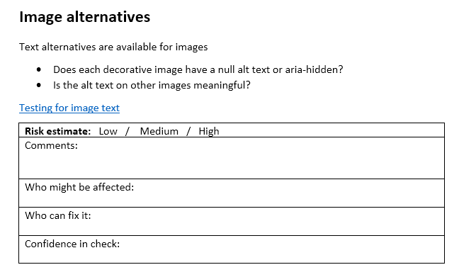
W3C Easy Checks / Quick Accessibility Checks
Page title
Image text alternatives ("alt text") (pictures, illustrations, charts, etc.)
Text:
Headings
Contrast ratio ("colour contrast")
Resize Text
Interaction:
Keyboard access and visual focus
Forms, labels, and errors (including Search fields)
General:
Moving, Flashing, or Blinking Content
Multimedia (video, audio) alternatives
Basic Structure Check
Notes:
The second level of testing is based around the “W3C Easy checks” which are designed to be quick and easy, rather than definitive.
[PROGRESS}
Alistair McNaught and Abi James have documented similar tests that can be completed with limited knowledge and tools.
….
These are on Lexdis at https://www.lexdis.org.uk/digital-accessibility/testing/quick-accessibility-checks/. They are based on the W3C Easy checks - https://www.w3.org/WAI/test-evaluate/preliminary/

Slide 60
Level 3 - More detailed testing, including with a screen reader
As expertise of accessibility testing grows, build a more sophisticated test plan that covers more criteria.
Example of UoS Digital Learning Team’s “level 3 accessibility test”.
Notes:
As our understanding grows we are building up our level 3 testing process, a link to which is on our presentation support site.

Slide 61
Level 4: Full Audit
Website Accessibility Conformance Evaluation Methodology (WCAG-EM)
Define Evaluation Scope
Explore Target Website
Select Representative Sample
Audit Selected Sample
Report Evaluation Findings
Notes:
Our aim is to reach the level of competence that we can potentially follow the Website Accessibility Conformance Evaluation Methodology to perform a full audit.

Slide 62

Accessibility Statement 0
Notes:
Even with the results of a Level 1 test we can start creating Accessibility Statements.
While accessibility statements should have a minimum set of information, there is the opportunity to add more information that’s relevant and useful for our users.

Slide 63
Promoting accessibility statements for our services will…
Build a culture of removing barriers to the use of our services.
Encourage reporting of accessibility defects, helping us to find new ways to improve our services and remove barriers.
Notes:
Promoting and communicating our statements can help to reinforce awareness, demonstrate that we care about removing barriers to the use of services, and encourage reporting of accessibility issues, helping us identify new ways to improve our services and remove accessibility barriers.

Slide 64




Automated testing to identify trends and quick fixes
Colour contrast
Use of headings
Missing alternative text
Text scaling and zooming disabled
Automated accessibility scanning.
Results, collated and organised.
Notes:
Command line tools such as Axe can be used at scale to identify issues across sites. It may help to identify “quick wins” that can be remediated just by adjusting CSS in the case of colour contrast, or adjusting the headers in the case where the viewport has been set to disable text scaling and zooming.
Identifying systemic fixes can help create momentum. It’s a positive way to communicate progress to secure greater commitment.

Slide 65
Question and answer break 2
Initiate
Implement
Sustain
Plan
We are here
Notes:
Before we look at the implement stage I’ll hand over to Tamsyn to see if there are any questions from the chat.
Over to you Tamsyn.

Slide 66
Planning and Managing Web Accessibility 3
Initiate
Implement
Sustain
Plan
Notes:
Thanks Tamsyn, It’s Matt here again looking at the “Implement” stage. This is where we embed accessibility throughout our processes.

Slide 67
Integrate goals into policies (and processes)
Build skills and expertise
Integrate goals into policies
Assign tasks and support delivery
Evaluate early and regularly
Prioritise issues
Track and communicate progress
Notes:
How can we integrate the goals from our accessibility policy within departmental processes?
We’re aiming to ensure that accessibility is considered an integral part of day-to-day activity.

Slide 68




Cost of accessibility bugs 1
Cost
Requirements Design Build Test Release
Source: Glenda Sims, Deque
Notes:
Considering the cost of bugs, the sooner we find them the less they cost to fix.

Slide 69
Cost of accessibility bugs 2
Cost
Requirements Design Build Test Release
Source: Glenda Sims, Deque
Notes:
And this is no different for accessibility issues.

Slide 70
Cost of accessibility bugs 3
The earlier we consider accessibility the better!
Cost
Requirements Design Build Test Release
Source: Glenda Sims, Deque
Notes:
So the sooner we consider accessibility within our IT processes the better.

Slide 71

Shifting left through the process (6)
Requirements
Design
Build
Test
Release
Shift left
Shift left
Notes:
Shifting left means testing earlier within our IT development life cycle, and this can be applied to accessibility as well.
{PROGRESS}
So testing for accessibility
{PROGRESS}
Considering accessibility when building
{PROGRESS}
Designing
{PROGRESS}
And gathering requirements
{PROGRESS}
And adding accessibility gateways within our change and release processes

Slide 72
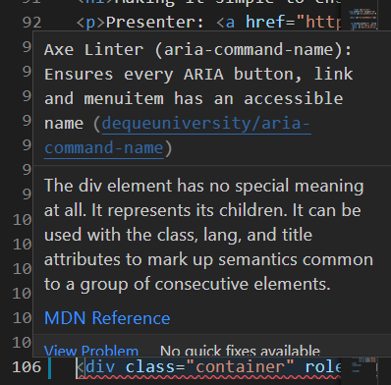
Shifting left through the process (7)
Build
Linters and IDE plugins.
Continuous integration
Behaviour Driven Development
Identify possible accessibility issues whilst coding.
Notes:
There are many available options in use in the field, let’s start by looking at building new sites and services.
Free Accessibility linters can be added to interactive development environments that add a kind of accessibility spell check for developers.
{PROGRESS}

Slide 73

Shifting left through the process (7)
Build
Linters and IDE plugins.
Continuous integration
Behaviour Driven Development
Notes:
Both commercial and open source options are available that allow for accessibility testing to be built into the Continuous integration process.
{PROGRESS}

Slide 74
Shifting left through the process (7)
Build
Scenario: A sighted keyboard-only user with a motor disability can operate an interface by only using a keyboard.
Given I am a sighted keyboard-only user with a user disability
When I navigate the page with the TAB key forwards and backwards
Then all interactive objects receive focus
And all interactive objects are operable
And all interactive objects receive focus in a logical order
And I can always visually tell what element has focus
Linters and IDE plugins.
Continuous integration
Behaviour Driven Development
Notes:
Behaviour Driven Development is often used to document and design a deliverable around the behaviour a user anticipates. A method often used for this is Gherkin. Gherkin is a business readable language which helps to describe business behaviour without going into technical implementation details. Writing accessibility requirements as Gherkin tests is an effective way to make accessibility expectations explicit.

Slide 75
Shifting left through the process (7)
Build
Scenario: A sighted keyboard-only user with a motor disability can operate an interface by only using a keyboard.
Given I am a sighted keyboard-only user with a user disability
When I navigate the page with the TAB key forwards and backwards
Then all interactive objects receive focus
And all interactive objects are operable
And all interactive objects receive focus in a logical order
And I can always visually tell what element has focus
Linters and IDE plugins.
Continuous integration
Behaviour Driven Development
Identify possible accessibility issues whilst coding.
Notes:
There are many available options in use in the field, let’s start by looking at building new sites and services.
{PROGRESS}
Free Accessibility linters can be added to interactive development environments that add a kind of accessibility spell check for developers.
{PROGRESS}
Both commercial and open source options are available that allow for accessibility testing to be built into the Continuous integration process.
{PROGRESS}
Behaviour Driven Development is often used to document and design a deliverable around the behaviour a user anticipates. A method often used for this is Gherkin. Gherkin is a business readable language which helps to describe business behaviour without going into technical implementation details. Writing accessibility requirements as Gherkin tests is an effective way to make accessibility expectations explicit.

Slide 76
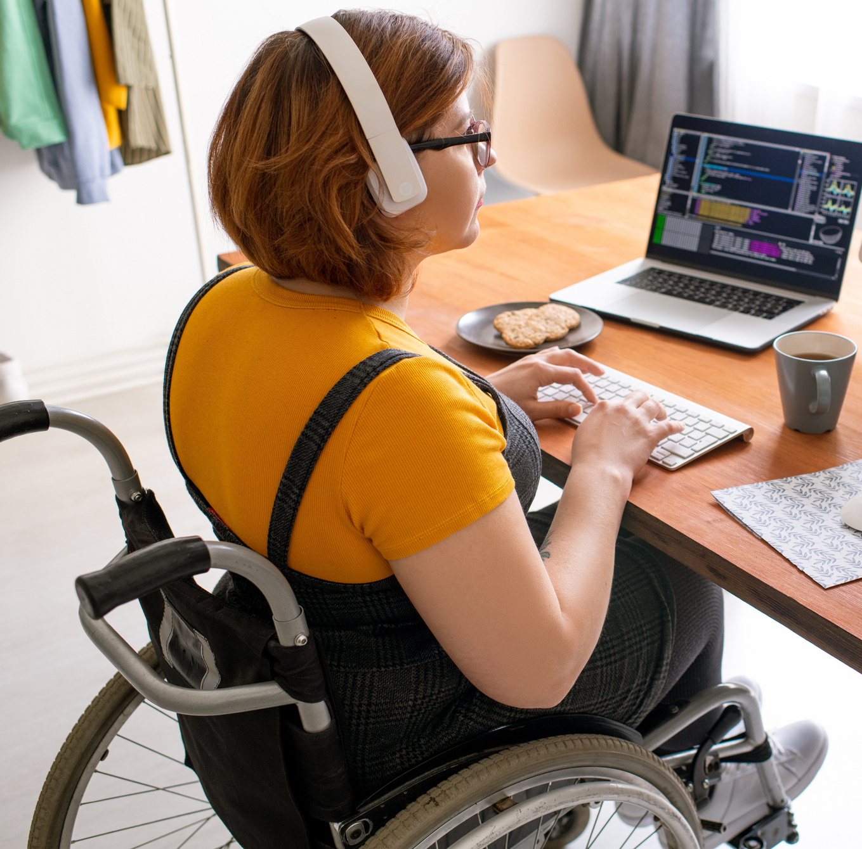
Shifting left through the process (8)x
Design
Involve users (including with impairments) in co-design.
Accessible component library and atomic design elements.
Annotate wireframes with accessibility details.
“Our perspective is that the best way to assess accessibility is to include the end users and hear their perspectives”
Fable TechLabs
Notes:
This leads us into areas to consider when designing.
For our services to be “accessible by design” it’s important to involve users with disabilities and impairments in the process.

Slide 77

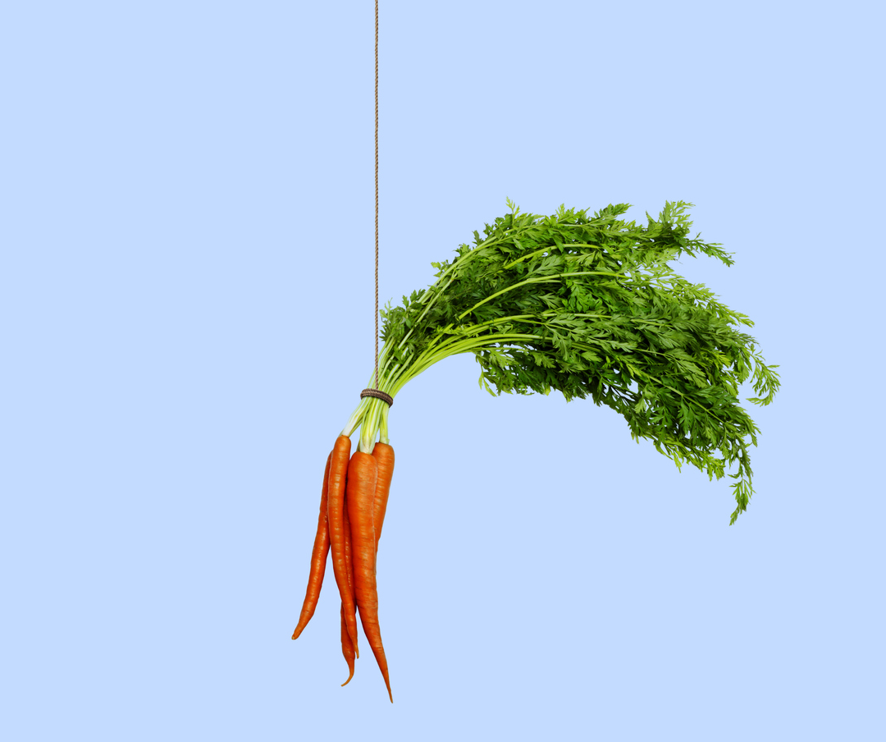
Shifting left through the process (8)x
Design
Involve users (including with impairments) in co-design.
Accessible component library and atomic design elements.
Annotate wireframes with accessibility details.
Groups and networks may be willing to help and happy to be asked.
Recognise people for their help.
Notes:
Within a University you’re likely to have both student and staff groups who would be happy to be involved. It’s important to recognise their contribution and time, particularly for testing.
An interesting example at the University of York is a group of student screen reader testers.

Slide 78

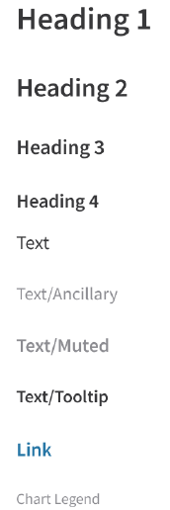
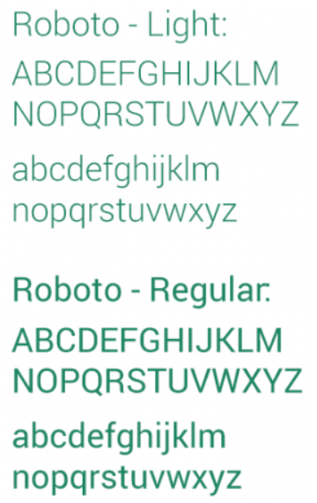
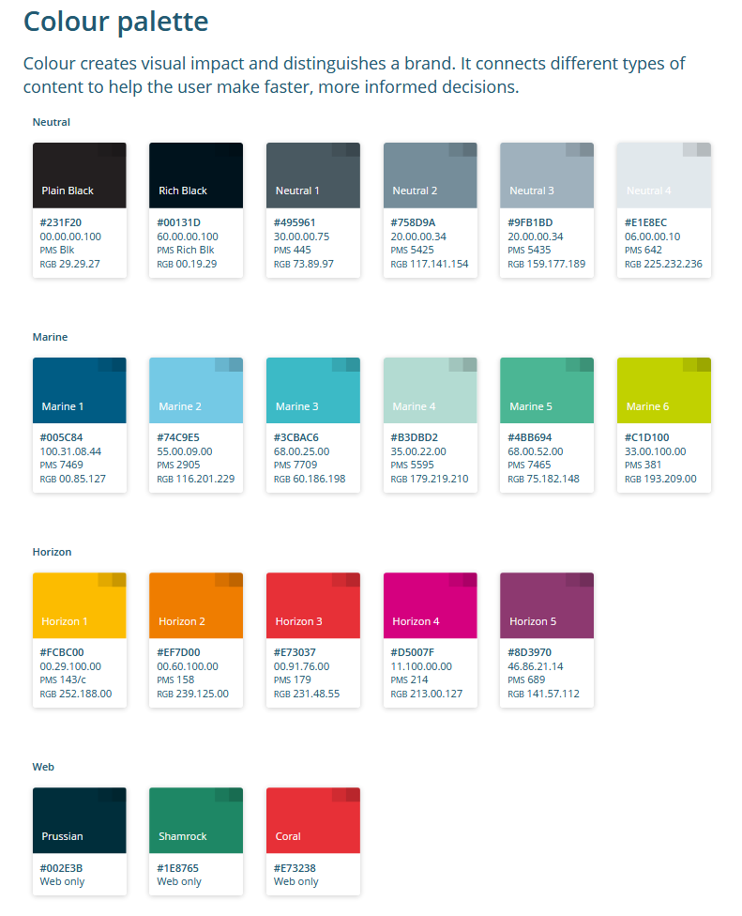
Shifting left through the process (8)x
Design
Involve users (including with impairments) in co-design.
Accessible component library and atomic design elements.
Annotate wireframes with accessibility details.
Notes:
Every University is likely to have a brand with colours, fonts, and other design “tokens”. Optimising the design system for accessibility, for example by using only a subset of a brand palette has sufficient contrast, can be the first steps toward building a component library.

Slide 79
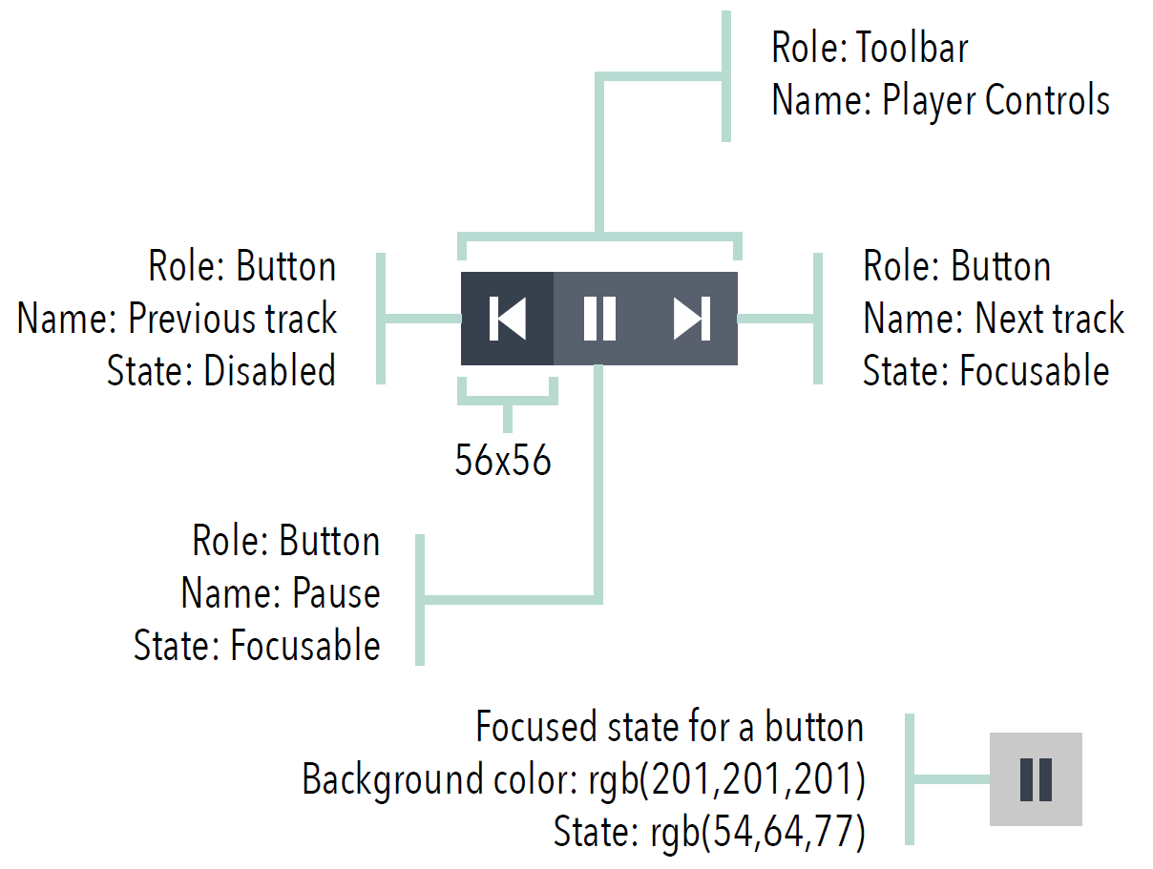
Shifting left through the process (8)x
Design
Involve users (including with impairments) in co-design.
Accessible component library and atomic design elements.
Annotate wireframes with accessibility details.
Communicate all necessary accessibility design intent so that designs can be turned into accessible applications, and this accessibility can be tested and validated efficiently.
Notes:
At the wireframe stage it’s recommended to include design intent so that developers don’t have to second guess how a design is meant to be accessible.

Slide 80
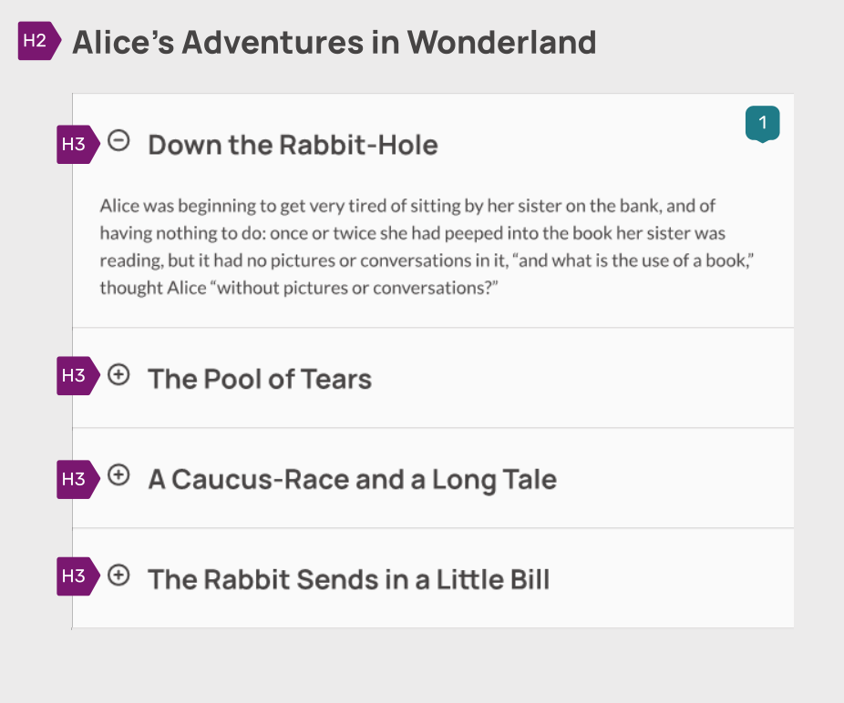
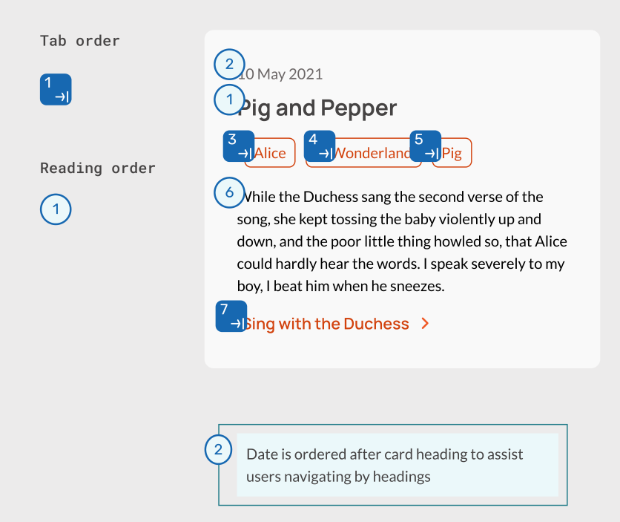
Shifting left through the process (8)x
Design
Involve users (including with impairments) in co-design.
Accessible component library and atomic design elements.
Annotate wireframes with accessibility details.
Notes:
Sarah Pulis and Claire Webber of Intopia
Have shared their accessibility annotation library for use in Figma
In this example headings, tab and reading order are annotated.

Slide 81
Shifting left through the process (9)
Requirements
Include accessibility within project documentation.
Accessible procurement
Add accessibility section to project brief, and business case documents.
Specify the production / updating of an accessibility statement as a deliverable.
Create a standard work-package for the creation of accessibility statements.
Notes:
Thinking about requirements,
{PROGRESS}
we can add accessibility within project documentation, for example requiring creation of accessibility statements,

Slide 82
Shifting left through the process (9)
Requirements
Role-based DoD Example
Include accessibility within project documentation.
Accessible procurement
Content creator
My content is written in plain language.
My content is clear and concise.
My content provides a blank alt text for decorative images.
My content provides brief, accurate descriptions for informative images.
etc
Developer
My code uses semantic elements/tags wherever possible.
My code contains logical structure that can be programmatically determined.
My code has all interactive elements accessible using TAB and include an outline.
My code allows for screen readers to read the content in a logical order and meaningful sequence.
etc
Notes:
And include Accessibility within the “Definition of Done”.
On the support site we share a role-based example of this, on screen, are examples for a content creator and a developer.

Slide 83
Shifting left through the process (9)
Requirements
Include accessibility within project documentation.
Accessible procurement
Require vendors to produce an Accessibility Conformant Report (ACR) for their product based on the Voluntary Product Accessibility Template (VPAT).
Ask about their accessibility roadmap.
Lobby current providers to improve accessibility and provide updates to their ACRs as products are upgraded.
Require accessibility within Non-functional requirements.
Notes:
Thinking about requirements,
{PROGRESS}
we can add accessibility within project documentation, for example requiring creation of accessibility statements,
{PROGRESS}
And include Accessibility within the “Definition of Done”.
On the support site we share a role-based example of this, on screen, are examples for a content creator and a developer.
{PROGRESS}
For commercial solutions we can require an Accessibility Conformance Report,
{PROGRESS}
an accessibility roadmap,
{PROGRESS}
lobby our vendors to prioritise accessibility,
{PROGRESS}
and include accessibility within non-functional requirements.

Slide 84

Shifting left through the process (10)z2
Release
Accessibility statement as part of go-live checklist
Accessibility testing as part of Change Management.
Review accessibility statements annually.
Dashboards.
Include the creation and publication of an accessibility statement within the “go-live checklist”.
Set date and ownership for reviewing the accessibility statement on an annual basis.
Accessibility Statement
Notes:
In terms of our our change and release processes,
We can require accessibility statements to be published or updated as part of go-live for new services or change approval for a significant upgrade.
{PROGRESS}
And set automated reminders for when accessibility statements should be reviewed and updated.
{PROGRESS}
We could include a section for accessibility testing within request for change forms
{PROGRESS}
as well as an entry for noting whether an update to the accessibility statement will be required.
{PROGRESS}
Continuing on from our point earlier about using automated tools to scan our sites for accessibility, there are examples online of using this data to populate dashboards.

Slide 85
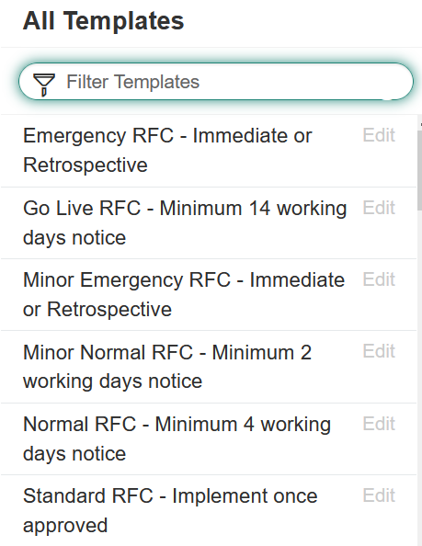
Shifting left through the process (10)z2
Release
Accessibility statement as part of go-live checklist
Accessibility testing as part of Change Management.
Review accessibility statements annually.
Dashboards.
Add accessibility testing into the RFC template.
Add step for checking if accessibility statement requires an update within RFC process.
Notes:
In terms of our our change and release processes,
We can require accessibility statements to be published or updated as part of go-live for new services or change approval for a significant upgrade.
{PROGRESS}
And set automated reminders for when accessibility statements should be reviewed and updated.
{PROGRESS}
We could include a section for accessibility testing within request for change forms
{PROGRESS}
as well as an entry for noting whether an update to the accessibility statement will be required.
{PROGRESS}
Continuing on from our point earlier about using automated tools to scan our sites for accessibility, there are examples online of using this data to populate dashboards.

Slide 86
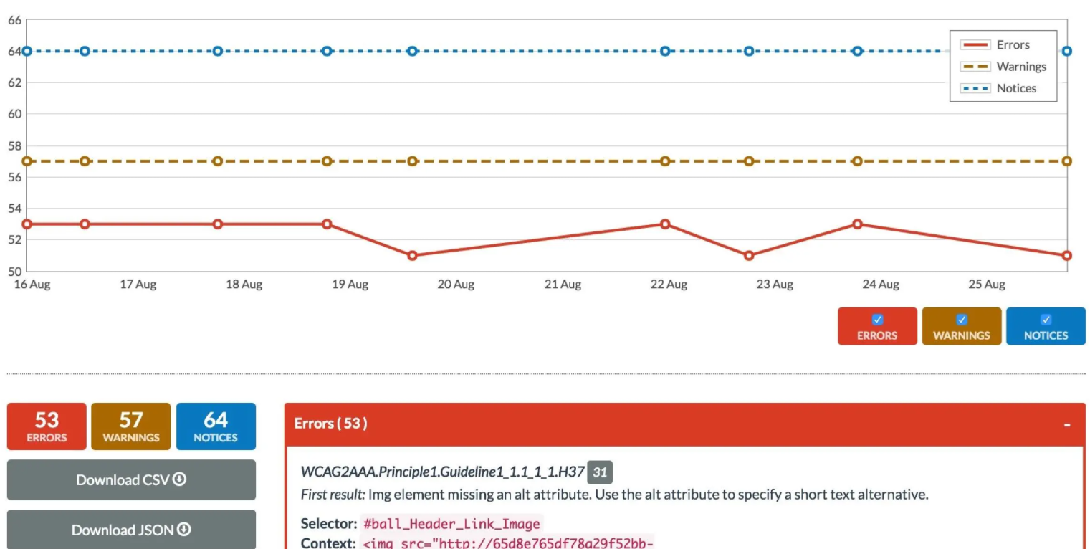
Shifting left through the process (10)z2
Release
Accessibility statement as part of go-live checklist
Accessibility testing as part of Change Management.
Review accessibility statements annually.
Dashboards.
Notes:
In terms of our our change and release processes,
We can require accessibility statements to be published or updated as part of go-live for new services or change approval for a significant upgrade.
{PROGRESS}
And set automated reminders for when accessibility statements should be reviewed and updated.
{PROGRESS}
We could include a section for accessibility testing within request for change forms
{PROGRESS}
as well as an entry for noting whether an update to the accessibility statement will be required.
{PROGRESS}
Continuing on from our point earlier about using automated tools to scan our sites for accessibility, there are examples online of using this data to populate dashboards.

Slide 87
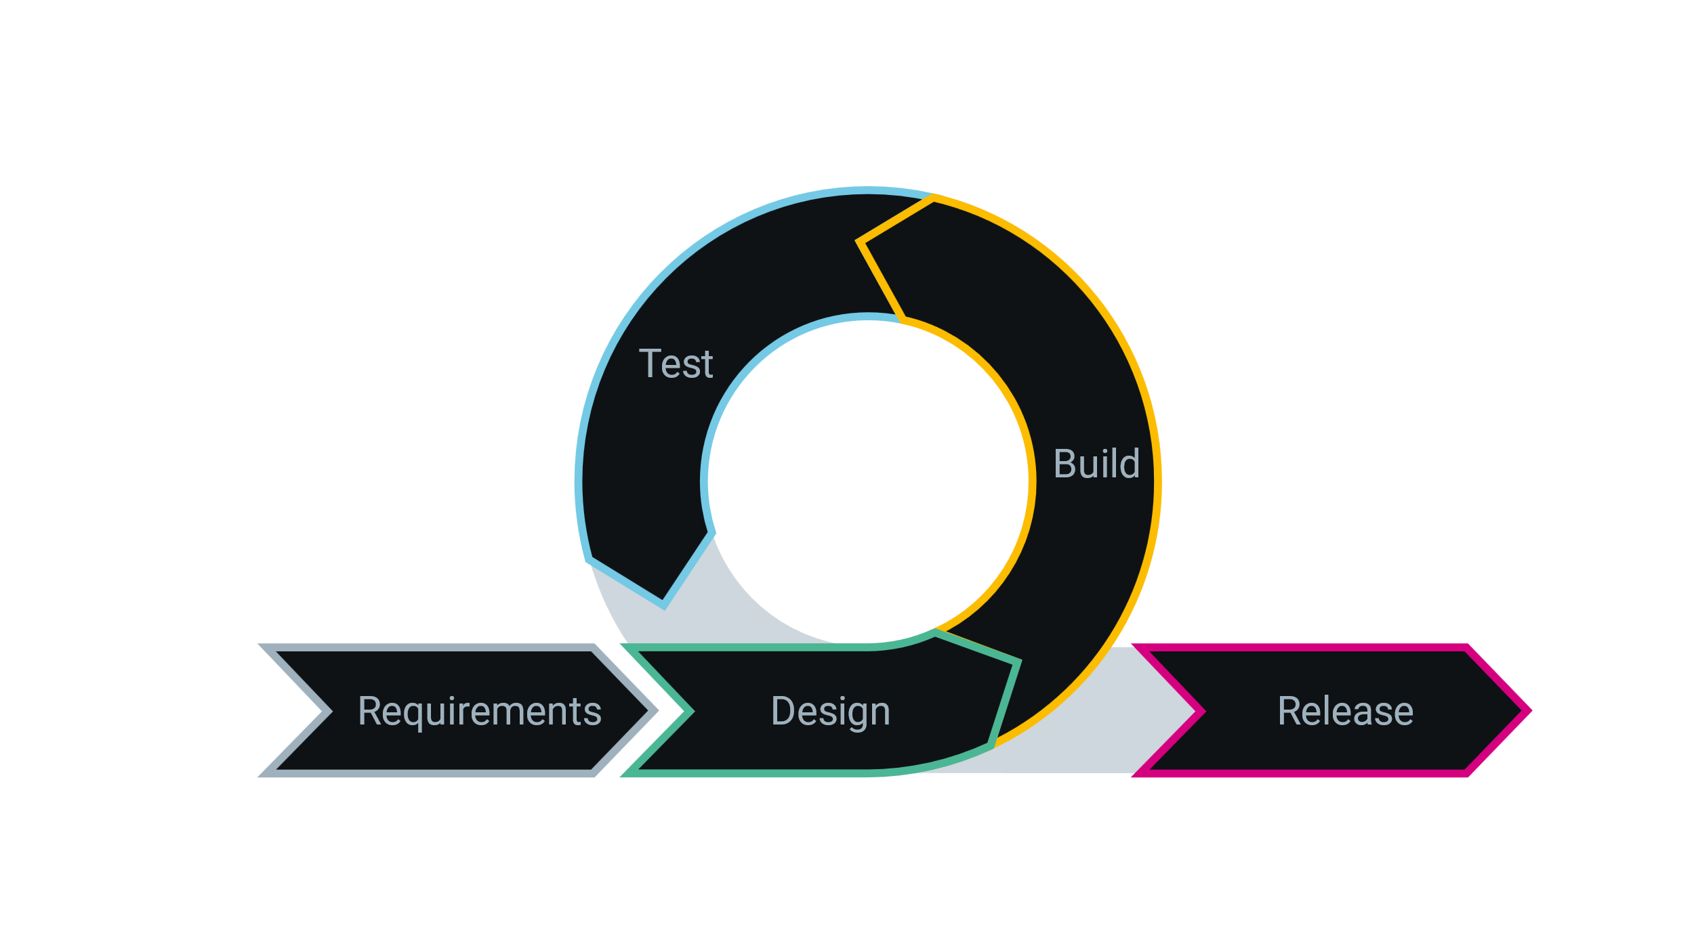
Waterfall / Agile
Requirements
Design
Build
Test
Release
Notes:
While the graphic I’ve been using is presented in a more waterfall style format,
{PROGRESS}
this is just as applicable in Agile. In the full slide deck I’ve added sections from the agile manifesto and how they can be related to accessibility. But to show you one today.

Slide 88
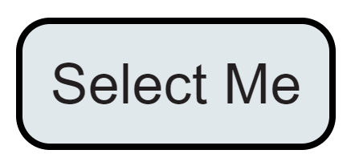
The art of maximizing the amount of work not done
<div id="divButton" class="button" onclick="doAction();" tabindex="0" role="button">Select Me</div>
function doAction() {
alert("Hello!");
}
const button = document.getElementById('divButton’);
button.addEventListener('click', () => {});
button.addEventListener('keydown', (event) => {
if (event.code === 'Space' || event.code === 'Enter') {
button.click();
}
});
<button onclick="doAction();">Select Me</button>
function doAction() {
alert("Hello!");
}
Using semantic HTML
Not using semantic HTML
Example on CodePen
Notes:
The art of maximising the amount of work not done is always an attractive proposition. Semantic HTML almost always has accessibility baked in. Compare on the left the amount of extra effort required to make a button keyboard accessible with the semantic example on the right.

Slide 89
Prioritise issues
Build skills and expertise
Integrate goals into policies
Assign tasks and support delivery
Evaluate early and regularly
Prioritise issues
Track and communicate progress
Notes:
While all accessibility objectives will need to be met, prioritising can help you achieve them more effectively.

Slide 90
Use resources effectively by addressing high impact, easy-to-resolve issues first.
Start with issues that are easier to fix: build motivation, demonstrate success.
Prioritise templates and components.
Prioritise visual design and accessible use of brand.
Prioritise procurement and recruitment policies.
Deprioritise issues related to systems you plan to retire.
Notes:
It’s important to build motivation by demonstrating initial success.
Finding issues that are straight-forward to fix can be an effective way to do this.
Examples might be
-adding really clear focus indicators that meet the new WCAG 2.2 criteria,
or changing “click here” links to be more descriptive.
[PROGRESS]
The accessibility of templates, components, and visual design can help to scale improvements and drive efficiencies.
Changes in the organisation can also bring opportunities, for example the adoption of a new brand. Service improvement programmes, for example migrating away from PDF forms toward more automated processes can give opportunities for accessibility as well.
[PROGRESS]
Procurement and recruitment are also important for scaling and sustaining accessibility.
[PROGRESS]
It probably goes without saying that if we plan to retire systems we can deprioritise fixing accessibility issues we find.
How can we prioritise the accessibility issues we find in general?

Slide 91
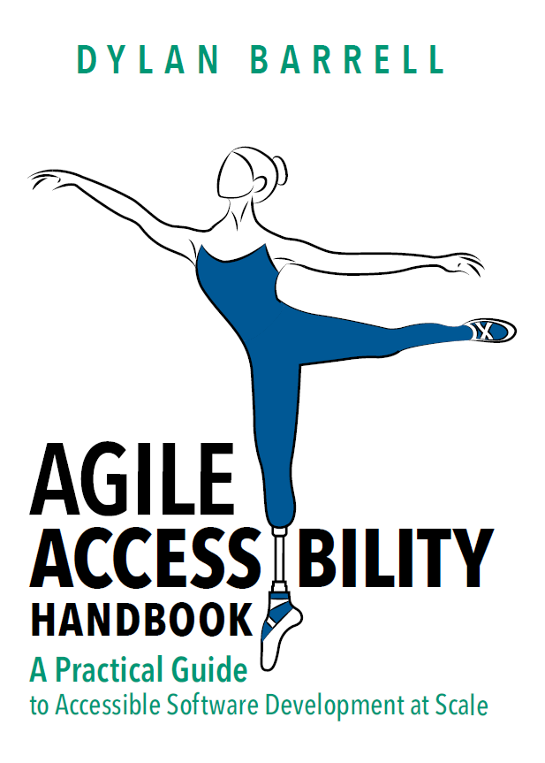
Agile Accessibility Handbook
https://accessibility.deque.com/agile-accessibility-handbook
Notes:
The Agile Accessibility Handbook has an excellent methodology for prioritising accessibility defects.

Slide 92
Critical issues
Priority | Criteria | Action
Critical | The issue affects at least one disability such that a critical business function cannot be used by a user with an affected disability. Think about the impact from this perspective: If all users could not use this functionality, would we consider that critical? | Stop deployment/release of affected software until the defect is remediated. If the defect is discovered in production, implement a hot fix immediately. If the hot fix cannot be implemented immediately, create alternative channel for achieving the functionality. Train Service Desk staff how to direct users to the alternative channel.
Notes:
Critical issues are when a business critical function cannot be used by someone with a disability.
Think of it in the same way as you would if the whole organisation could not perform this function.

Slide 93
Serious issues
Priority | Criteria | Action
Serious | The issue affects at least one disability such that critical business functionality can only be used with an acceptable workaround, or the issue affects functionality that is not essential, but prevents at least one disability from being able to use this functionality. | Fix the defect in the very next deployment/release. Update accessibility statement with the workaround and train Service Desk staff on how to deal with the issue.
Notes:
Serious issues are like critical issues but where there is a workaround.

Slide 94
Moderate
Priority | Criteria | Action
Moderate | The issue affects functionality that is not essential and has an acceptable workaround. | Update accessibility statement with the workaround. Train Service Desk staff on how to deal with the issue. Assign defect fix priority in a similar way to defects that affect general site usability.
Notes:
Moderate issues affect non-essential functions and that have a workaround.

Slide 95
Minor issues
Priority | Criteria | Action
Minor | The issue affects functionality in a distracting way e.g., duplicate accessible names, presentational elements that are not marked as presentational, or inconsistent use of markup. | Assign defect fix priority in a similar way to defects that affect brand, consistency of use, and look-and-feel.
Notes:
Minor issues are those that would be distracting but do not affect functionality.

Slide 96
Question and answer break 3
Initiate
Implement
Sustain
Plan
We are here
Notes:
Before we look at the sustain stage I’ll hand over to Tamsyn to see if there are any questions from the chat.

Slide 97
Planning and Managing Web Accessibility 4
Initiate
Implement
Sustain
Plan
Notes:
Embedding accessibility within our processes is so important because we’re aiming for accessibility to be within all our IT department’s activities.
What can we do to sustain our accessibility efforts?

Slide 98
Sustain
Monitor services
Engage with stakeholders
Track standards and legislation
Adapt to new technologies
Incorporate user feedback
Notes:
We should monitor our services, both in terms of automated tests, and as services are upgraded, redesigned, or our processes change. When you find issues it’s a great opportunity to refine training and processes.
{PROGRESS}
Keep working with your stakeholders, for example:
Raising awareness of accessibility work and its benefits. If you have set up Key Performance Indicators, check they remain relevant.
Seek long-term engagement within the department. Champions networks and communities of practice can help to sustain the momentum.
Keep talking to your suppliers and monitor their accessibility roadmaps.
{PROGRESS}
Keep track of changes to standards and legislation. Updates to the web content accessibility guidelines are around the corner. The Government will be publishing its reflections on the first year of monitoring soon.
{PROGRESS}
New technologies bring new opportunities. There’s always a new operating system, browser, development framework. The accessibility community is regularly sharing new, optimized practices you can benefit from.
{PROGRESS}
Most importantly, invite user feedback and use it to help guide improvement activities and identify areas in need of attention. Keep communicating accessibility improvements and how they benefit your user community.
Now I’ll hand back to Tamsyn to bring us to our conclusion.

Slide 99

Conclusion
Notes:
Let’s conclude by summing up what we’ve covered and some final thoughts.

Slide 100
In this presentation we aimed to
… but we didn’t have all the answers
Place digital accessibility within a wider-context.
Introduce a pathway for implementing digital accessibility within your IT department.
Share practical examples of how accessibility can be embedded within the policies and processes of an HE IT department.
We’re all at different stages in this journey.
As a community we can share practices and progress.
We’ll follow up unanswered questions after this event.
Notes:
We put some accessibility trends in context and introduced you to a pathway for implementing digital accessibility within your IT department, sharing practical examples.
[Next]
We didn’t have all the answers – we’re all at different stages of this journey, but as a community we can share practices and progress.

Slide 101
Planning and Managing Web Accessibility a2
Initiate
Plan
Implement
Sustain
Learn the basics
Develop business case
Gather support
Create policy
Assign responsibilities
Budget / resources
Review
websites
Integrate goals into policies
Prioritise issues
Overview
Notes:
We covered some aspects of the “Planning and Managing Digital Accessibility” pathway.

Slide 102
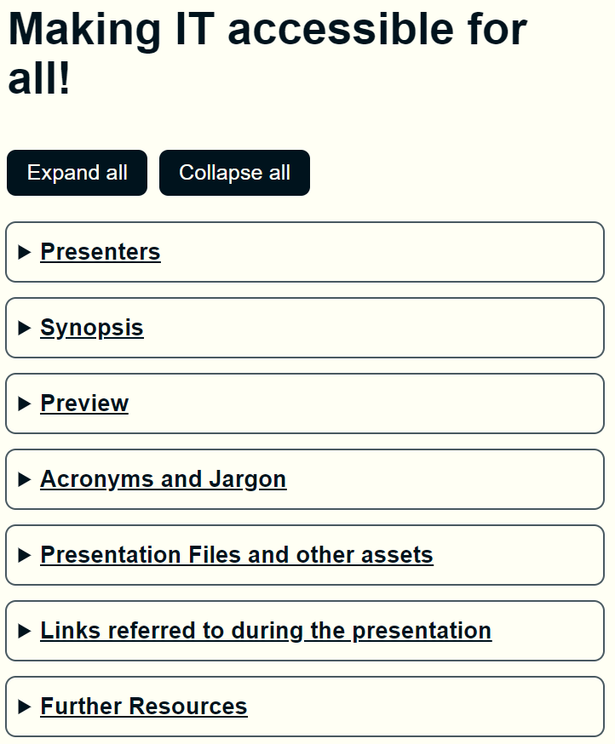
More resources on the support site
Slide decks
Artefacts
Links
Video with corrected captions and transcript
https://go.soton.ac.uk/ucisa
Notes:
The full slide deck covers all aspects of that pathway, made relevant to University IT departments and it’s available on our presentation support site, the address is go.soton.ac.uk/ucisa
There you can find a number of further artefacts we have produced or collated, along with all the links we refer to in the slide deck.
In a few weeks, the video of today’s session with corrected captions and a transcript will be available on the site .

Slide 103

Final thoughts
Notes:
Time for a few final thoughts.

Slide 104

Karl Groves, Founder and President, Tenon.io
“From a security perspective you’re always gonna filter, escape, and validate any input that comes from the outside world… you've got that pattern in your head ‘filter, validate, escape’. It's how you do things all the time. Same thing goes for accessibility, once you start doing accessibility it becomes how things get done and then it’s not extra work”
Notes:
In a recent interview, Karl Groves founder of accessibility agency Tenon.io, said, “From a security perspective … you've got that pattern in your head ‘filter, validate, escape’. It's how you do things all the time.
Same thing goes for accessibility, once you start doing accessibility it becomes how things get done and then it’s not extra work”
As we’ve attempted to show, embedding accessibility within our processes and practices makes it become just something that we do. The expected baseline.

Slide 105
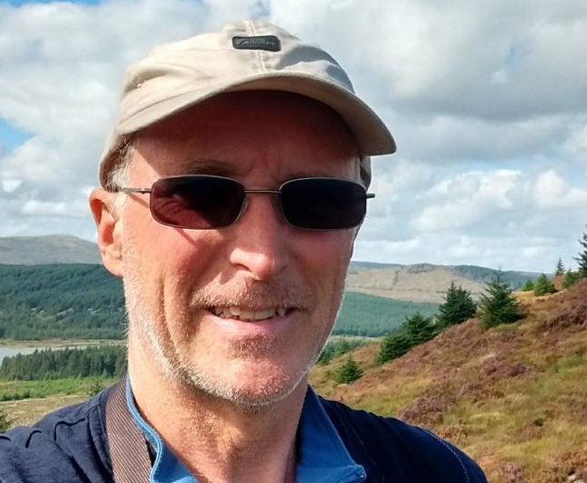
Alistair McNaught, accessibility consultant
“…compliance does not guarantee a good experience any more than non-compliance guarantees a bad one”
Notes:
We can go further, Alistair McNaught, the accessibility consultant says “…compliance does not guarantee a good experience any more than non-compliance guarantees a bad one”
It’s through the communication, partnership, and co-design that we can go beyond standards to make for a truly inclusive experience.

Slide 106
Continue the conversation
The full slide deck has a suggested roadmap for your next steps.
We will try to follow up questions we did not answer today in the follow-up email.
JISC Accessibility Community
Notes:
At the end of the full slide deck we’ve added a suggested roadmap for your next steps. We’ll try and follow up any questions we could not answer in a follow up sent to you in a few days.
Continue the conversation on the JISC accessibility community and make sure to join their monthly drop-in sessions.

Slide 107

Thank you
Notes:
Thank you for your time today, and thanks especially to Sian Thomas at UCISA for working so hard in the background to make this event a success.

Slide 108
Question and Answer / Discussion
Notes:
We’ll use the remaining time to go through any questions in the chat and open up for further discussion. If you have a question you would like to ask “in person” feel free to put up your hand on Teams.

